Slide 1
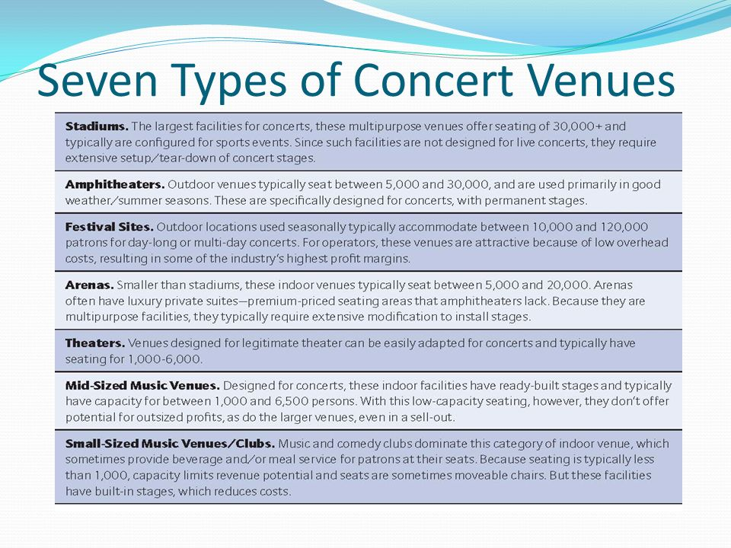
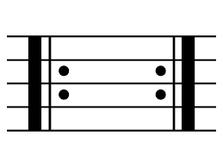
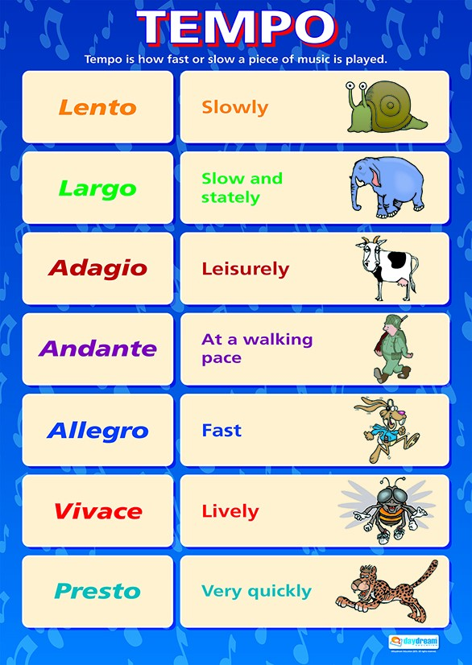
Y9 Music Knowledge Organiser.
Music notes on Treble and Bass Clef.
Repeat symbol
What is the key signature of a song?
A key signature is a visual symbol, printed on a musical staff, that indicates what key a section of music is written in. Key signatures are represented by using accidentals—better known as sharps and flats
Pop Music Structure

