Slide 1
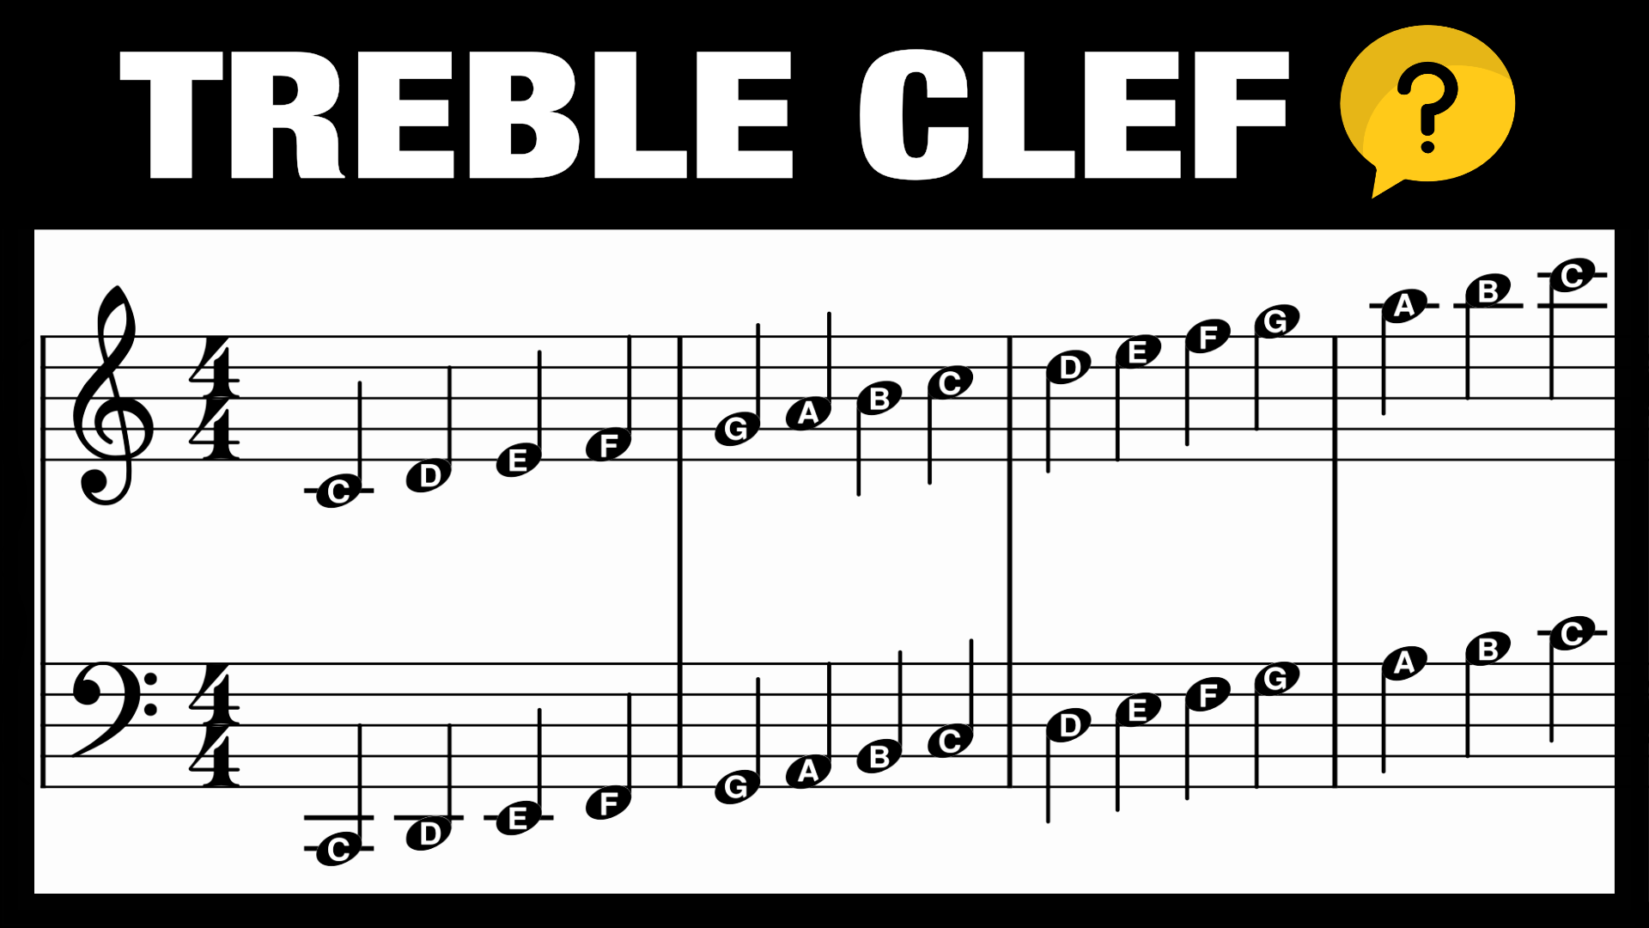
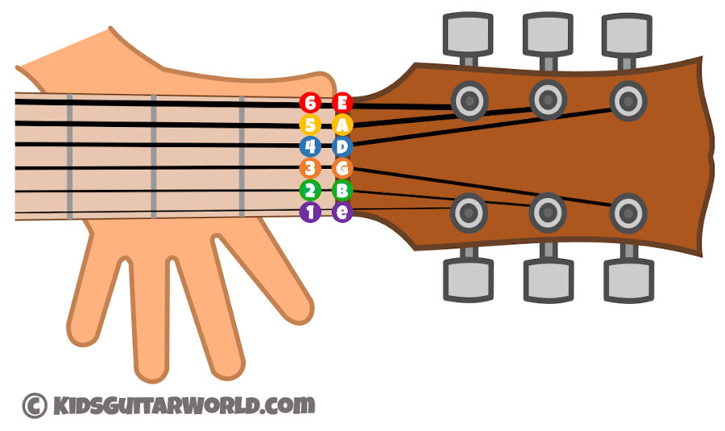
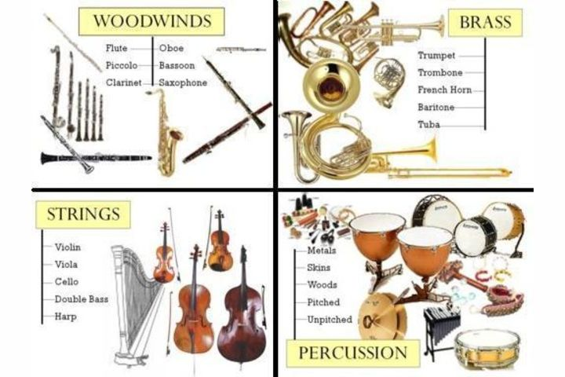
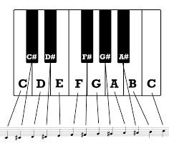
Y8 Music Knowledge Organiser.
A digital audio workstation (DAW) is music production software that allows users to record audio on a personal computer. ... It is used for audio recording, audio editing, MIDI editing, mixing, and mastering, among other functions. DAW software powers sessions in professional recording studios and home studios alike.

